Slide 1
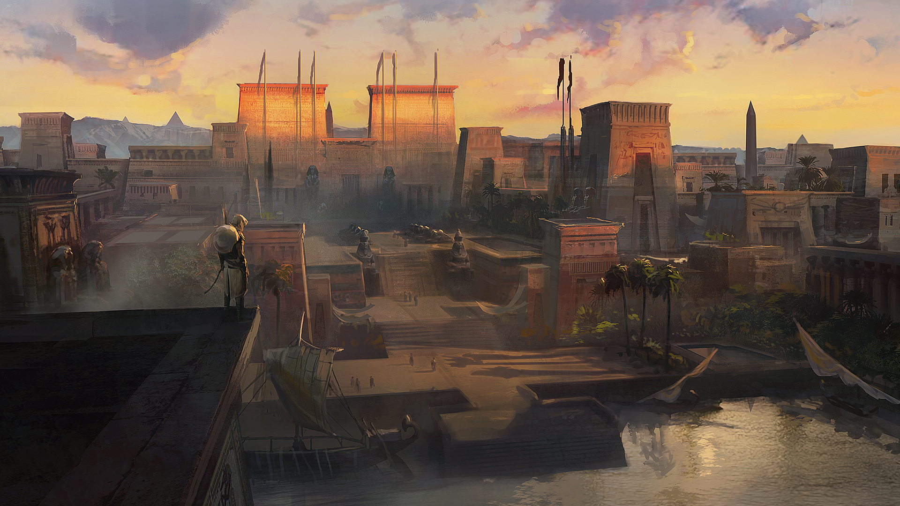

Commit Assistant – ML to predict and prevent bugs in Ubisoft’s code
Mathieu Nayrolles
@mathieunls

Slide 2
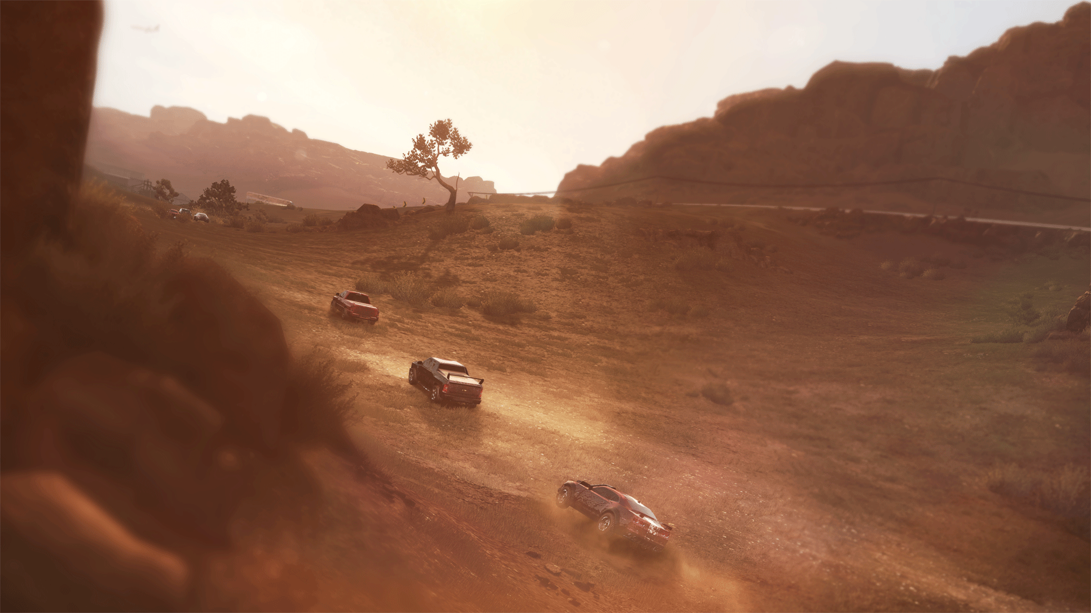

We do AAA video games like Prince Of Persia, Assassins Creed, Rainbow Six, Far Cry, Watch Dogs, …
We have ~13,000 employees on 32 locations across 6 continents
2

Slide 3



Fixes
Fixes
Fixes
Fixes
Fixes
Fixes
Fix

Slide 4
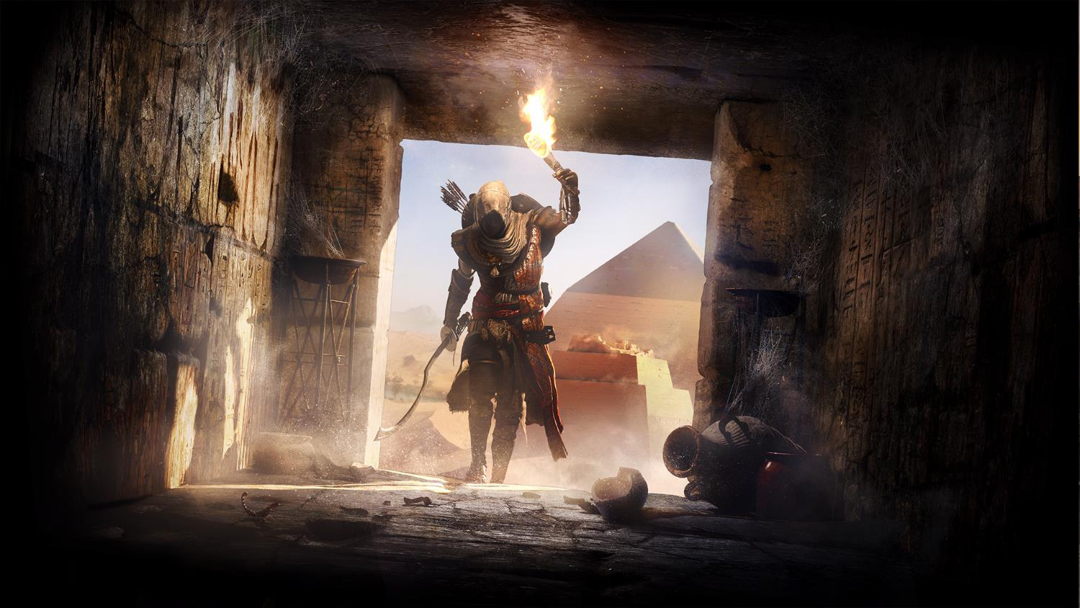
We combined code metrics with clone detection for JIT fault prevention and resolution
79% precision & 65% recall on fault prediction
66% of the proposed fixes are accepted by humans
4

Slide 5
We combined code metrics with clone detection for JIT fault prevention and resolution
Number of lines added
Number of lines deleted
R-Exp
Entrophy
Number of contributors
….
5

Slide 6
We combined code metrics with clone detection for JIT fault prevention and resolution
Pieces of code that are copy/pasted across the code-base with little to no-modification
Considered a bad practice
Lot of approaches to find them
6

Slide 7
We combined code metrics with clone detection for JIT fault prevention and resolution
Real-Time
Commit-Time
Integration-Time
…
7

Slide 8
We combined code metrics with clone detection for JIT fault prevention and resolution
Abnormal behavior of a system that may lead to a crash
Classifiers are hard to sell without a recommender counterpart.
8

Slide 9
79% precision & 65% recall on fault prediction
Buggy
Sane
9

Slide 10

+ using System;
+ public class Test
+ {
+ public static void Main()
+ {
+ Console.WriteLine("Hello JDA; let's sort...");
+ int[] array = new int[]{1, 5, 6, 2, 3};
+ for(int i=0; i<array.Length; i++){
+ for(int j=0; j<array.Length - 1; j++){
+ if(array[j] > array[j+1]){
+ int tmp = array[j+1];
+ array[j+1] = array[j];
+ array[j] = tmp;
+ }
+ }
+ }
+
+ Console.WriteLine(string.Join(",", array));
+ }
+ }
A[] = A[]
for(
B=0
B<A.Length
B++
){
for(
C=0
C<A.Length
C++
){
if(
A[C] >
A[C+1]
){
D = A[C+1]
A[C+1] = A[C]
A[C] = D
}
}
}
11

Slide 11


public class Test
{
public static void Main()
{
Console.WriteLine("Hello Ubi; let's sort...");
int[] array = new int[]{1, 5, 6, 2, 3};
for(int i=0; i<array.Length; i++){
- for(int j=array.Length; j<array.Length - 1; j++){
+ for(int j=i; j<array.Length - 1; j++){
if(array[j] > array[j+1]){
int tmp = array[j+1];
array[j+1] = array[j];
array[j] = tmp;
}
}
}
Console.WriteLine(string.Join(",", array));
}
}
for(
C=B
C<A.Length
C++
){
if(
A[C] >
A[C+1]
){
D = A[C+1]
A[C+1] = A[C]
A[C] = D
}
}
for(
C=A.Length
C<A.Length
C++
){
if(
A[C] >
A[C+1]
){
D = A[C+1]
A[C+1] = A[C]
A[C] = D
}
}
STABLE
BUGGY

Slide 12


public class Test
{
public static void Main()
{
Console.WriteLine("Hello Ubi; let's sort...");
int[] array = new int[]{1, 5, 6, 2, 3};
for(int i=0; i<array.Length; i++){
- for(int j=i; j<array.Length - 1; j++){
+ for(int j=array.Length; j<array.Length - 1; j++){
if(array[j] > array[j+1]){
int tmp = array[j+1];
array[j+1] = array[j];
array[j] = tmp;
}
}
}
Console.WriteLine(string.Join(",", array));
}
}
for(
C=0
C<A.Length
C++
){
if(
A[C] >
A[C+1]
){
D = A[C+1]
A[C+1] = A[C]
A[C] = D
}
}
for(
C=A.Length
C<A.Length
C++
){
if(
A[C] >
A[C+1]
){
D = A[C+1]
A[C+1] = A[C]
A[C] = D
}
}
BUGGY
STABLE

Slide 13

for(
C=A.Length
C<A.Length
C++
){
if(
A[C] >
A[C+1]
){
D = A[C+1]
A[C+1] = A[C]
A[C] = D
}
}
for(
C=B
C<A.Length
C++
){
if(
A[C] >
A[C+1]
){
D = A[C+1]
A[C+1] = A[C]
A[C] = D
}
}
for(
C=0
C<A.Length
C++
){
if(
A[C] >
A[C+1]
){
D = A[C+1]
A[C+1] = A[C]
A[C] = D
}
}
STABLE
BUGGY
STABLE

Slide 14

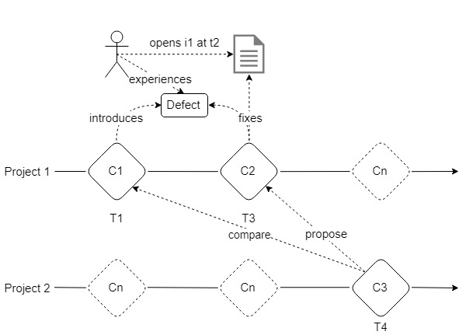
Pattern Matching Works
Notes:
Talk about clustering

Slide 15

Pattern Matching Works … But
Does NOT Scale:
Games are heavy
Engines are long lived systems
We have many games and many engines
15

Slide 16
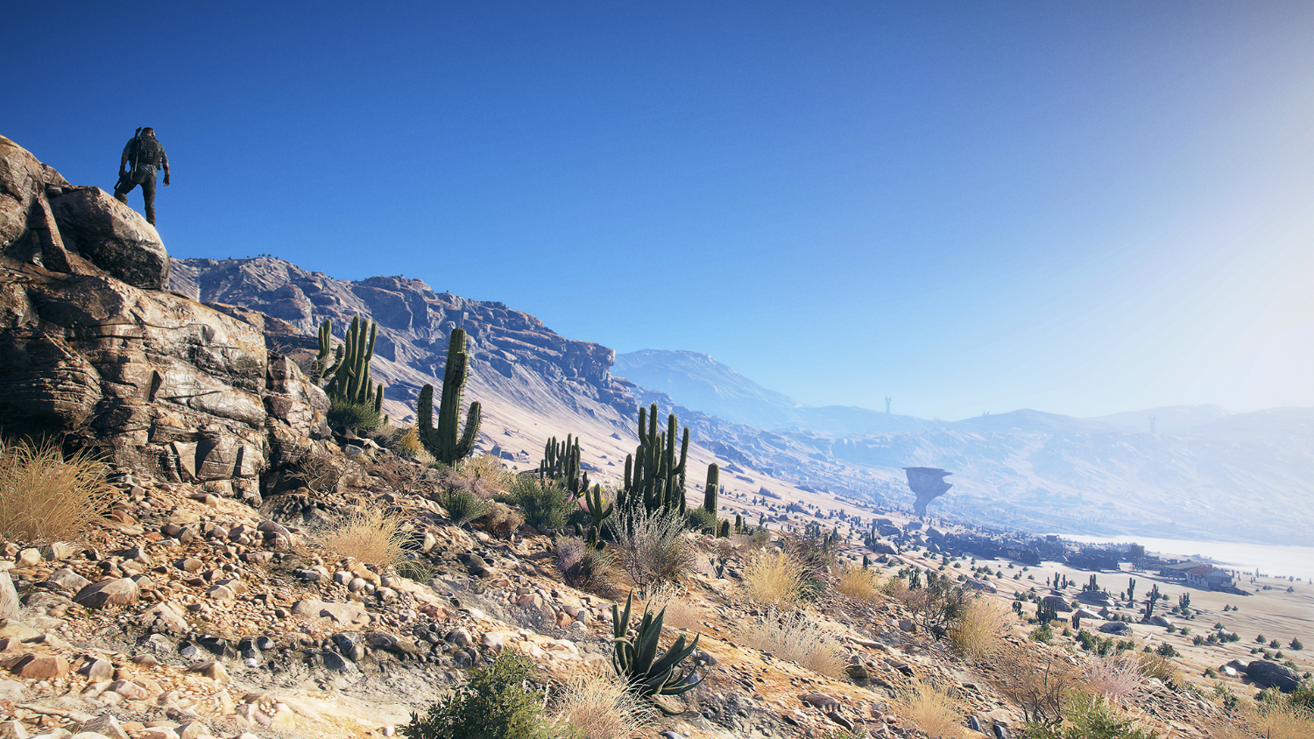
Tackling Performances
Two-steps classifier
Metrics
la, ld, nf, exp, entropy, ...
Random Forest
Code Pattern Matching
Project Clustering by Using their Dependencies
16
Notes:
Metric based classifier inspired by Commit-guru by Shihab et al but rewritten to support ultra large repository and use our management tools for classification rather than NLP on commit message.
Ultimately it’s based on the SZZ algorithm

Slide 17
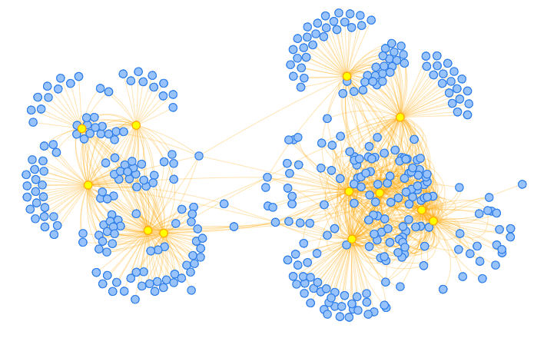

Slide 18
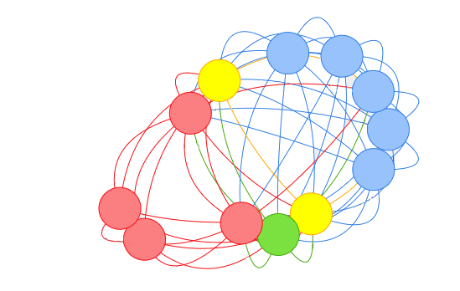

Slide 19

Tackling Performances
Metric classification computation time is negligible
Pattern classification computation time varies from ~2 seconds to ~25 seconds on our internal compute farm

Slide 20

Path To Resolution
Propose the top 1 fix from past patterns according to code-block similarity to a panel of experts
They accepted 66% of the fixes as being helpful in order to craft the actual fix
Gives confidence in the prediction
Actionable actions

Slide 21

Commit-Assistant Conclusion
Fault prevention with acceptable precision (79%) and recall (65%) that scale on ultra-large repositories
~Valid path to resolution (66%)
We are currently working at deploying it to our teams

Slide 22

(Not so) Fun Facts about ML at Scale
Too … Much … Data …
Classifier are nothing without recommender
ML is hard … ML as a service for hundreds of thousands of requests a day is harder
ML is (obviously) bound by data, what we produce is the limit

Slide 23
(Not so) Fun Facts about ML at Scale Cont’d
ML is (obviously) bound by data, what we produce is the limit
Every step along the way have value

Slide 24

laforge.ubisoft.com
@mathieunls
@ubisoftmtl

Slide 25

Q&A

